Slide 1
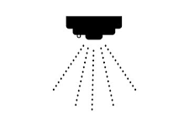
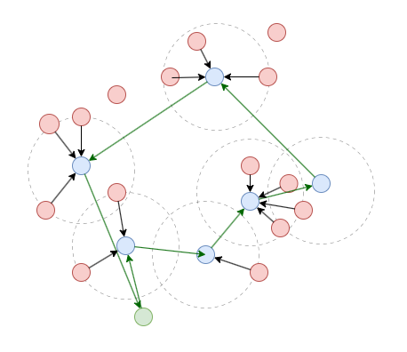
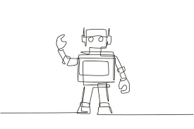
Revisiting Data Collection in Robotic Sensor Networks: A Budget-Constrained Traveling Salesman Perspective
Soham Patil*, Yutian Chen#, Bin Tang*
*California State University Dominguez Hills, Department of Computer Science #California State University Long Beach, Department of Economics
Notes:
Good Afternoon everyone, this presentation is going to be a overview of our paper Revisiting Data Collection in RSN: A B-Constrained Travelling Salesman Perspective. I am Soham patil and Dr. Bin Tang from CSUDH and Dr Yutian Chen from CSULB are the co-authors of this research paper.

Slide 2
I Introduction
II Network and Mobility Model
III Problem Formulation
IV Algorithmic Solutions
V Simulation Setup
VI Performance Evaluation
VII Conclusion
VIII Future Work
Outline
Notes:
This would be the outline of today’s presentation. First I will introduce the WSN and talk about existing and new data collection approaches. Next we will formulate the problem and discuss the algorithms used to solve it. I will then share the simulation setup which I have used for getting the result and discuss it. Finally I will conclude the presentation along with future work.

Slide 3
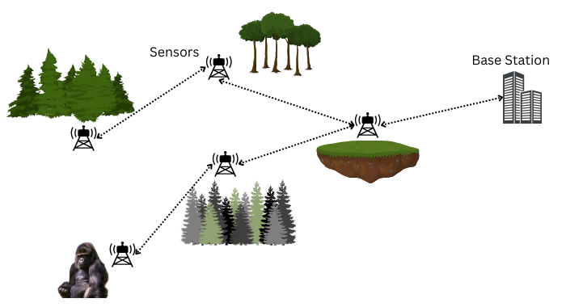
Introduction
Wireless Sensor Networks
Sense
Collect
Transmit
Notes:
WSN refer to network of spatially dispersed and dedicated sensors that monitor and record the environmnet around them and forward the collected data to a data center.
These sensor nodes are battery powered and use the energy to sense, collect and transmit the data to the base station. This data is then processed for useful analysis of real world applications.
From the name itself we can understand that they rely on wireless connectivity to transfer the data.

Slide 4
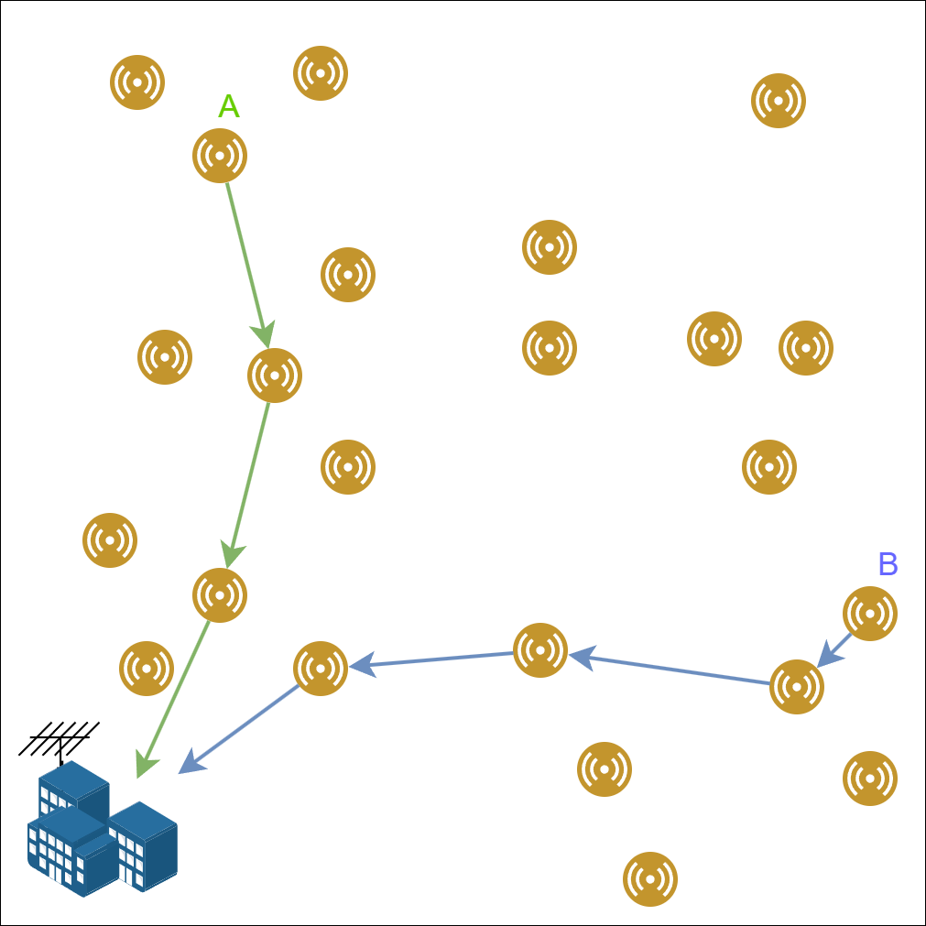
Introduction
Traditional Approach
Transmission Range
Overall network life is less
Offload all data packets
Notes:
The traditional approach is a multi hop approach. It means that nodes communicate with each other over multiple hops to extend coverage beyond a single hop radio range. For example see how node and B will transfer the data to base station. All nodes have transmission range and can send the data to nodes within that range. For the hops, the nodes send and receive the data, this causes them to use up energy according to first order radio model. So this will use up energy of the nodes and make them useless pretty quick.

Slide 5
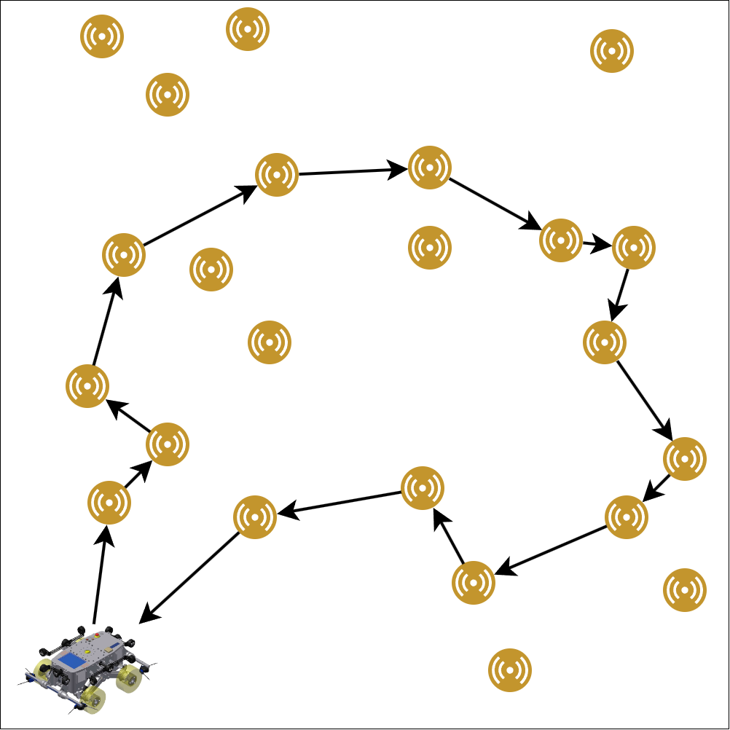
Robotic Sensor Networks
Mitigate Energy Limitations
Limited Battery
Path Planning
Notes:
In this paper we focused on the use of Robots in Wireless Sensor Networks for the data collection. As we know that these sensor nodes have unreplensihble battery, we mitigate the energy limitations of the whole network by introducing the robot as the data collector. We saw in the WSN that the network will get exhausted pretty quickly. Another major issue on which we shed a light in this research paper is the limited battery the robots have and the need for efficient ppath planning within the battery constraint in large scale WSNs.

Slide 6
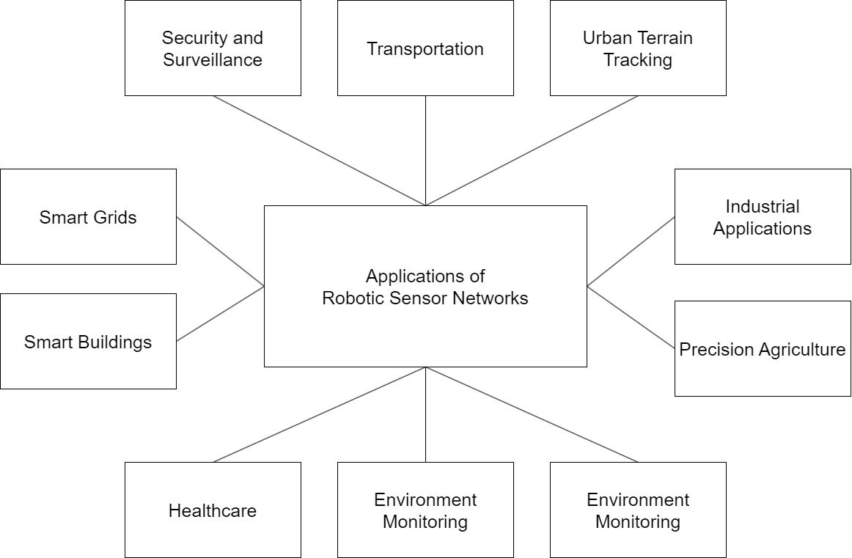
Notes:
Wide range of applications in several industries which include transportation, Industrial monitoring, Healthcare and the most important of all environment monitoring
The application of wireless sensor network has been a breakthrough in collecting resource in terrains which are not easily reachable by humans such as in dense rainforests and deep under the ocean. These nodes are used to monitor air quality and forest fire detection among other earth sensing application

Slide 7
Robotic Sensor Networks
Mitigate Energy Limitations
Limited Battery of the robot
Path Planning
Notes:
So what RSN is that the robot will go directly to the sensor nodes location and just offload the data from the node, as distance between them is negligible the transmission energy spent is also negligible. Now we go back to where I talk about limited battery of the robot. The robot also has a limited battery, but it can charge itself at base station and then go again in the network. No existing literature has focussed on this constraint. Where the robot cannot visit all the nodes in the network and has to visit only a subset of it while collecting large amount of data.

Slide 8
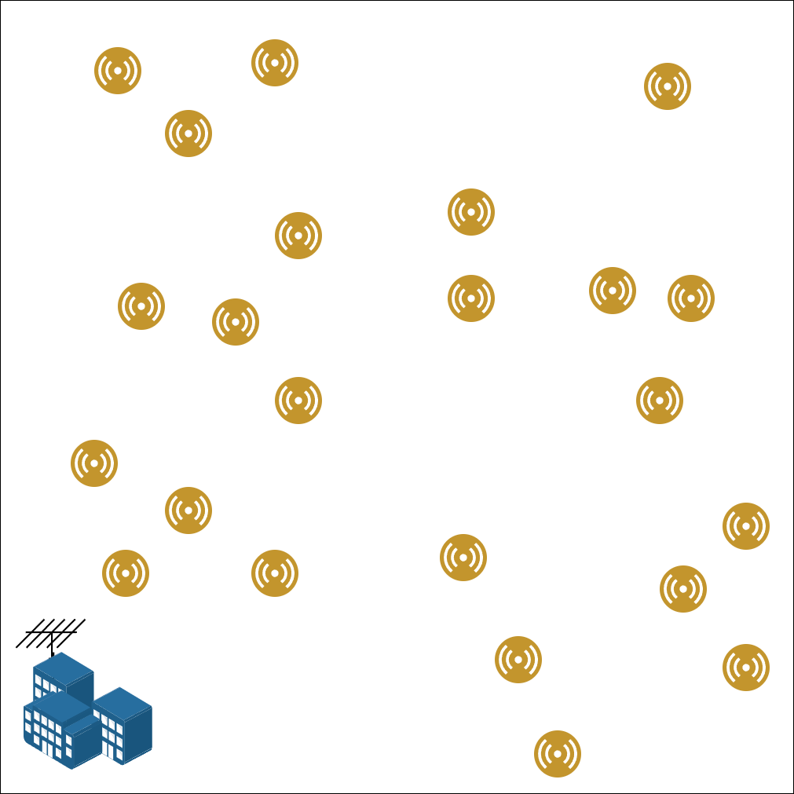
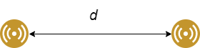


Network Model
A rectangular area of l meters by m meters. Let V_{s} = {1, 2, ..., |V_{s}|} denote the set of |V_{s}| sensor nodes randomly located in the RSN, with i ∈ V_{s} located at the location (x_{i} , y_{i})
d_{i} >= 0
Unreplenishable (0,0)
Notes:
So lets look at the network model that we have in our research paper

Slide 9
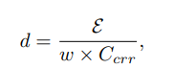
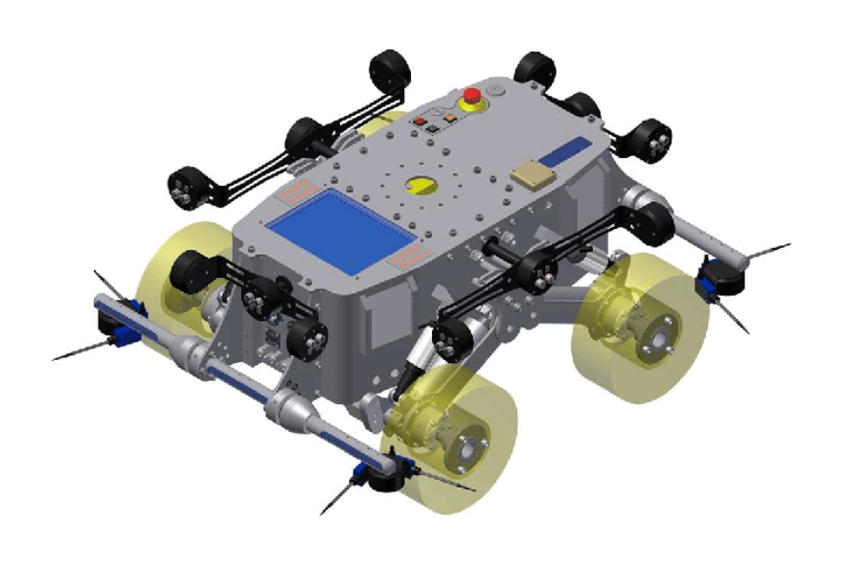
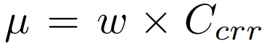
Mobility Model
Mobility energy of a robot includes all the energy needed to keep the robot in motion, such as the drive motor, steering motor, and related energy losses.
Rechargeable

Slide 10

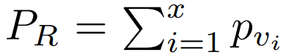

Problem Formulation
Let R = {r, v₁, v₂, ..., v_{x}, r} denote a data-collecting route of the robot, where the robot starts from depot r, moves to a sequence of sensor nodes v_{i} ∈ V_{s} to collect their data packets, and finally returns to depot r.
Battery power spent by robot on Route R
Prize collected on Route R
Given the initial battery power B of the robot, the goal is to find a data-collecting route R to maximize the total prizes P_{R} it collects while returning to r without running out of its battery power; that is, B_{R} ≤ B
Notes:
Battery feasible nodes are the nodes which the robot can visit from the current node and then have enough battery to go back to depot. This makes sure that it doesnt die before returining to the depot.

Slide 11
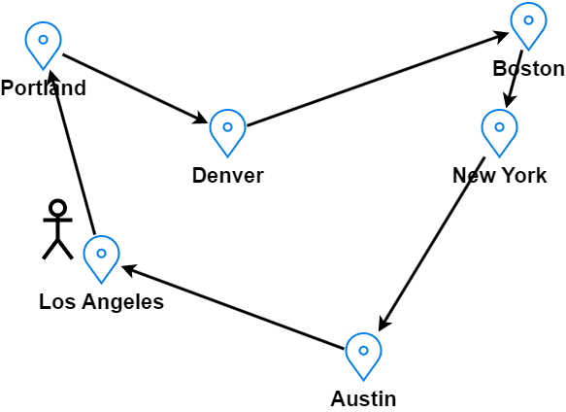
Budget-Constrained Travelling Salesman Problem (BC-TSP)
Notes:
One of the most important contribution of this paper is that we prove that BCDCR is equal to BC TSP.

Slide 12
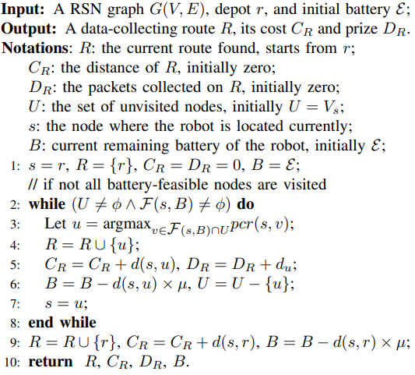
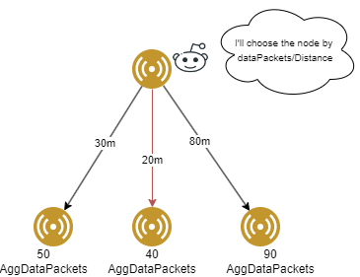
Algorithms
Greedy Algorithm (Prize Cost Ratio)

Slide 13
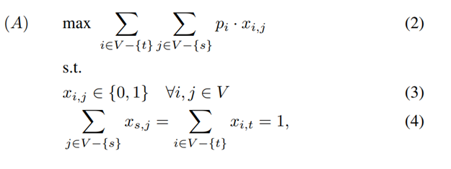
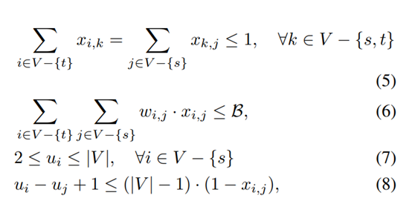
Algorithms
Integer Linear Programming
Notes:
Objective function 2 is to maximize the total number of collected data packets.
Constraint 3 is the integer constraint of xi,j .
Constraint 4 guarantees that the data-collecting route starts and ends at node r.
Constraint 5 ensures the connectivity of the path and that each node is visited at most once. Constraint 6 guarantees that the total battery power spent by the robot on the data collecting path does not exceed its initial battery power of E. Constraints 7 and 8 are Miller–Tucker–Zemlin (MTZ) Subtour Elimination Constraints [2], which guarantees that there is one global tour visiting all the selected vertices (otherwise, there could be multiple subtours each visiting only a subset of the selected vertices)

Slide 14
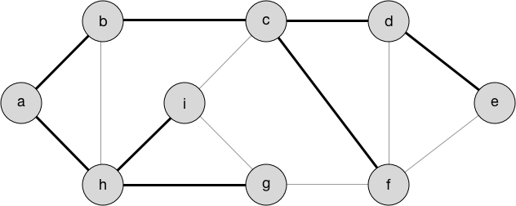
Algorithms
Spanning Tree [1]
+ Integer Linear Programming
[1] M. Ma, Y. Yang, and M. Zhao. Tour planning for mobile data gathering mechanisms in wireless sensor networks. IEEE Transactions on Vehicular Technology, 62(4):1472–1483, 2013.

Slide 15
Simulation Setup
Energy Model for Data Collection
To transmit 1 bit = 100 nJ
To receive 1 bit = 100 pJ
Sensor Node
1 data packet = 400B / 3200 bits
Energy required to sense 1 data packet = 0.108 Joules (happens hourly)
Energy of a sensor node = 6480 Joules
Robot
Energy required by the robot to travel 1 meter = 100 Joules
Network Size
1000m by 1000m
Nodes
30
Data Range
[0, 100] Data Packets randomly generated
Java on Windows 11 with AMD Processor (AMD Ryzen 5 4000 Series 6-Core) and 24GB of DDR4 Memory

Slide 16
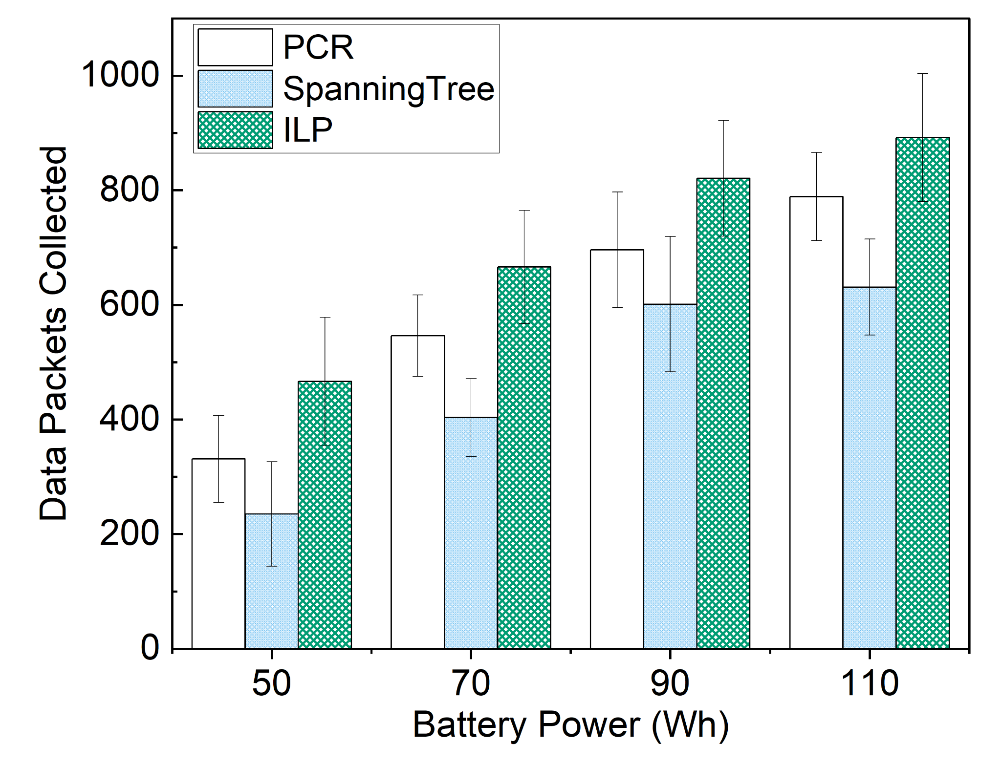
Performance Evaluation

Slide 17
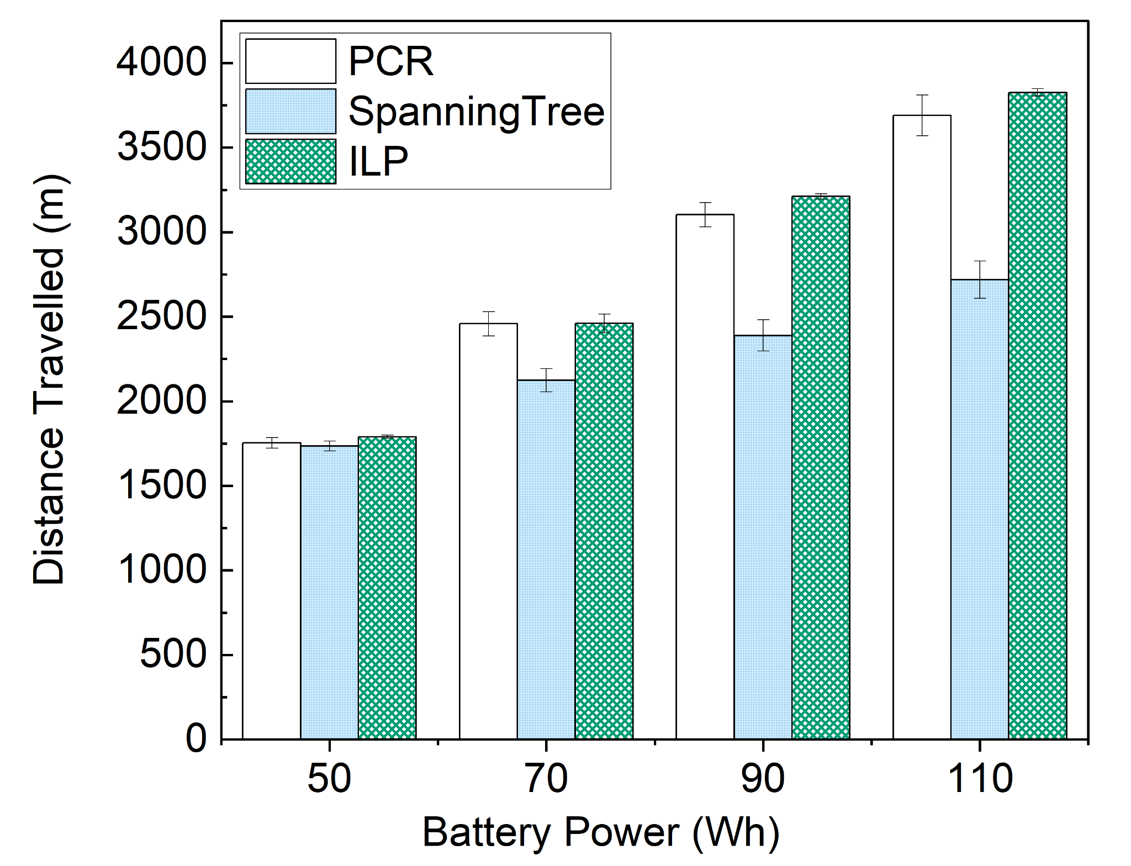
Performance Evaluation

Slide 18
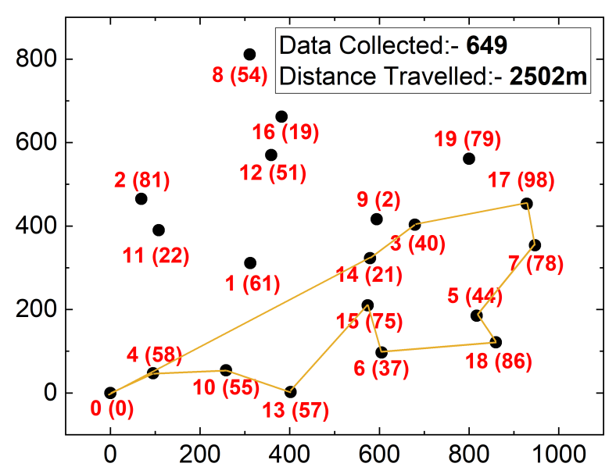
Performance Evaluation
Data Collecting Path - PCR

Slide 19
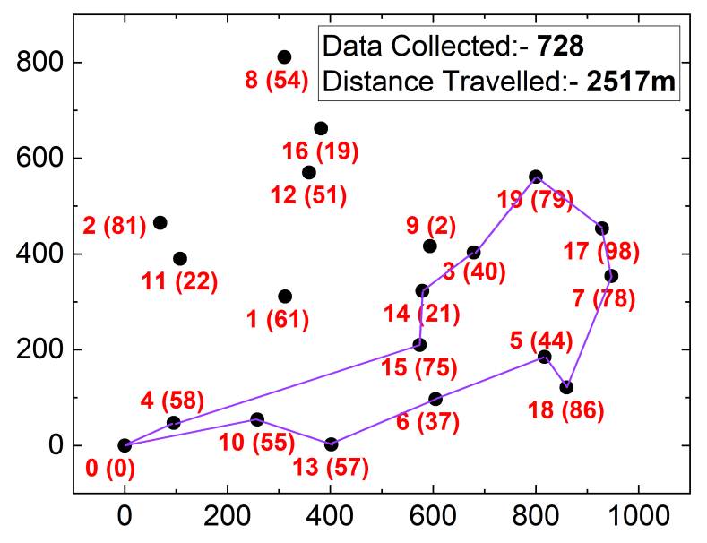
Performance Evaluation
Data Collecting Path - ILP

Slide 20
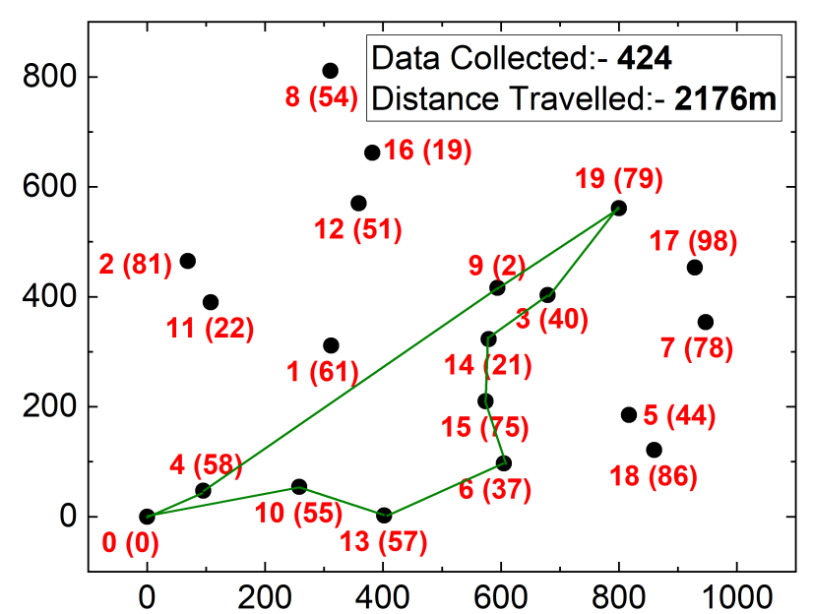
Performance Evaluation
Data Collecting Path - Spanning Tree

Slide 21
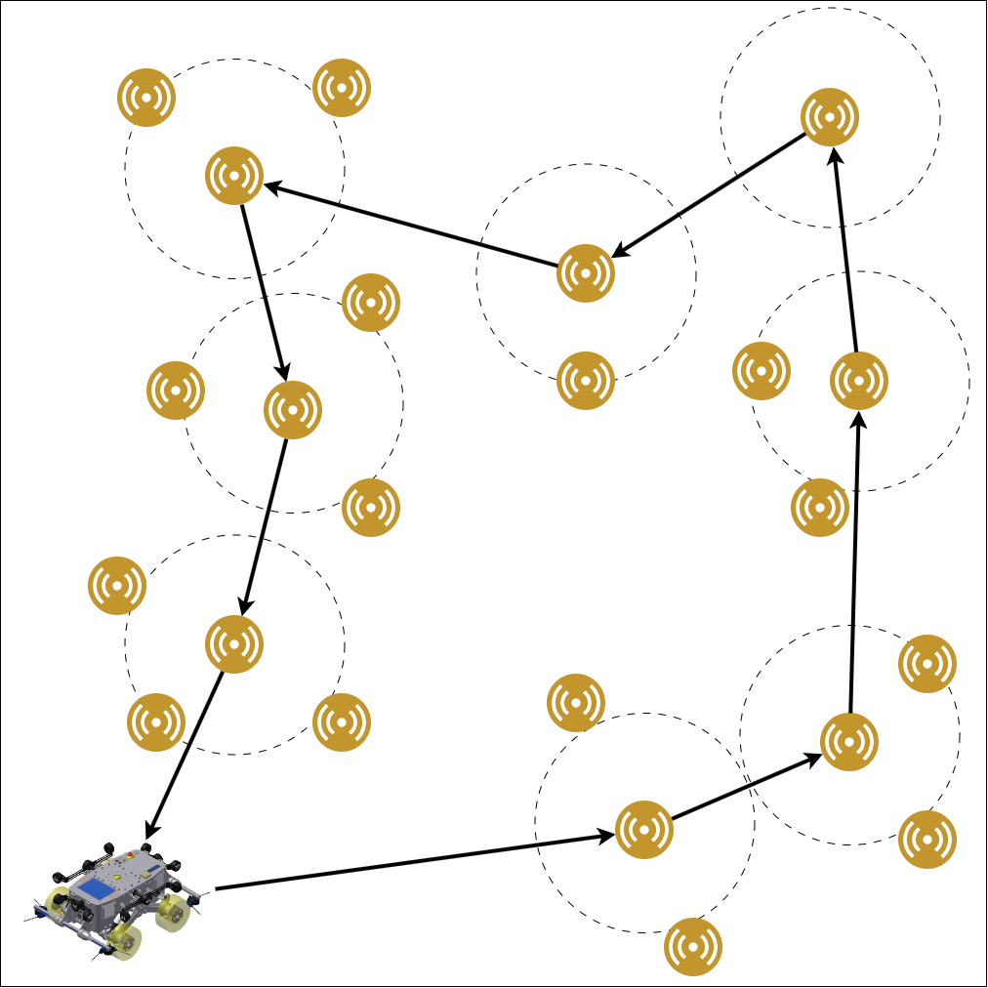
Covering Salesman Problem
Collect Data from multiple nodes
Limited Battery of the robot
Nodes spend more energy
Notes:
Another existing literature talks about the a covering salesman approach. In this one we only visit some anchor points or cluster head nodes. These cluster head nodes collect data from other nodes in its range to itself so that the robot visits it it can collect data from multiple nodes. Even in this approach no one talks about the battery constraint of the robot. One downside of this is that nodes spend energy to send the data to cluster nodes, which also makes the TSP approach superior and see it when we discuss the results.

Slide 22
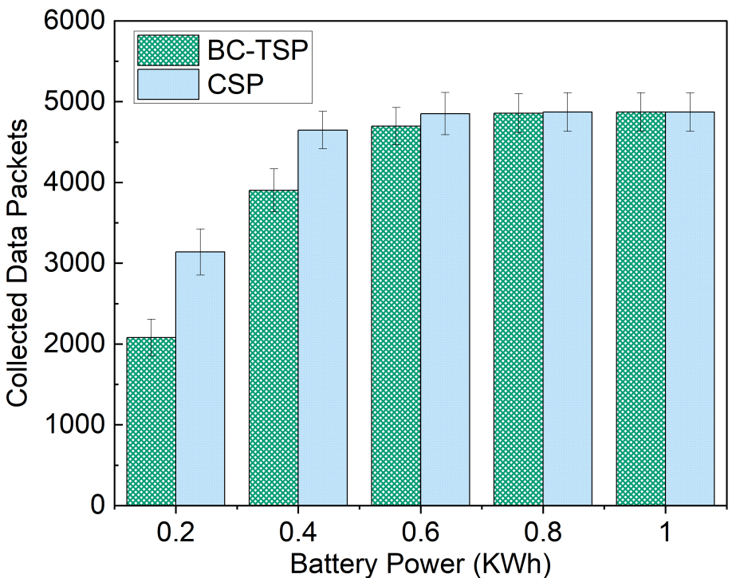
Performance Evaluation
CSP vs BC-TSP Comparison

Slide 23
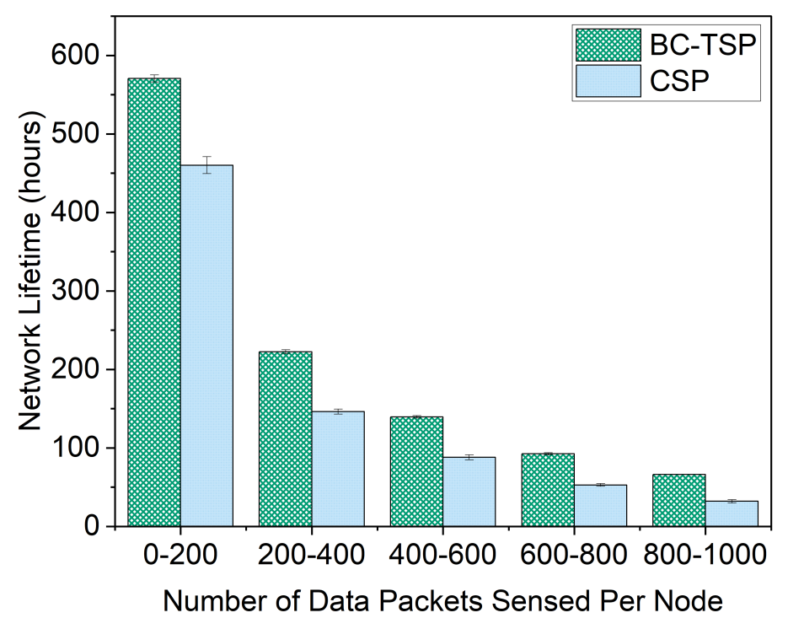
Performance Evaluation
Network Lifetime Comparison

Slide 24
Conclusion
Our Contribution:
We identify battery-constrained data collection problem in RSN and show it is equivalent to BC-TSP, a new variation of the classic TSP problem.
Experimental results:
PCR and ILP collect 29.01% more packets than the Spanning Tree with the same battery power.
TSP vs. CSP:
TSP approach achieves 32.02% more network lifetime of the RSN compared to the existing literature using a CSP.

Slide 25
Future Work
Consider receiving energy consumption of robot.
Model a reinforcement learning algorithm to solve the BC-TSP.
Consider the dynamic generation of data in real time.

Slide 26
Acknowledgements
This work was supported by NSF Grant 2240517.

Slide 27
Thank You

